Slide 1



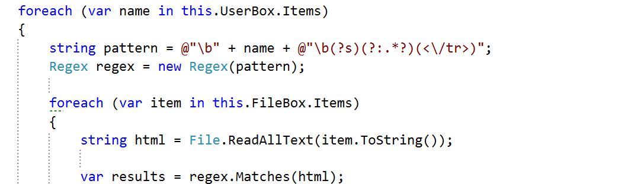
C# OOP Advanced
Course Introduction
OOP Advanced
SoftUni Team
Technical Trainers
Software University
http://softuni.bg

Slide 2


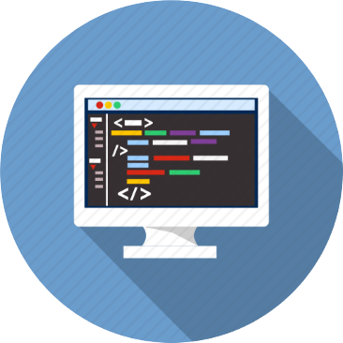
Table of Contents
Course Objectives
Course Program
Trainers Team
Course Schedule
Exams and Evaluation
Learning Resources

Slide 3







SoftUni Diamond Partners

Slide 4
Questions
sli.do #CSharp-Fund

Slide 5
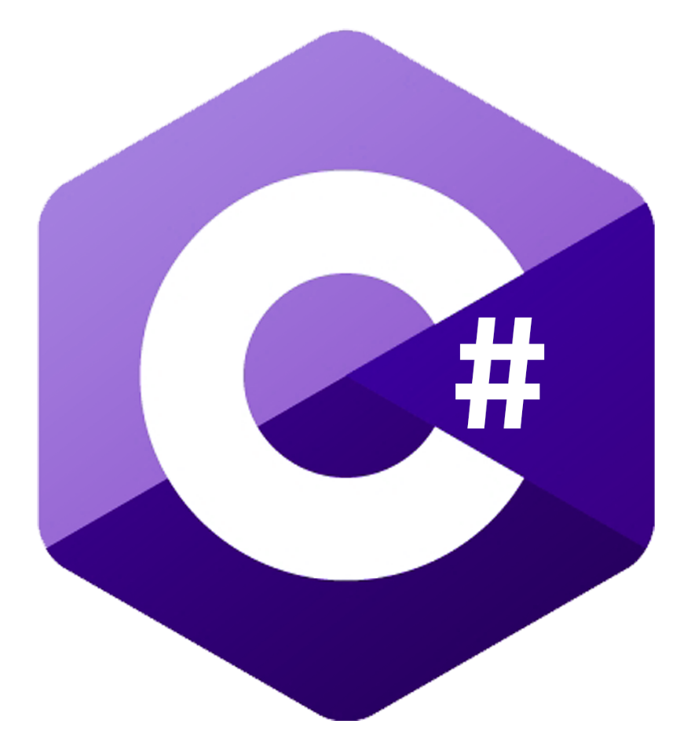
C# Fundamentals Module @ SoftUni
Database Fundamentals
Intensive 4 Months C# Training

Slide 6
C# Fundamentals Module Goals
4 months intensive C# training
4 times weekly, lots of live coding and homework
Part I – C# Advanced
Stacks & Queues, Matrices, Streams, Functional Programming
Part II – C# OOP Basics
Defining Classes, Encapsulation, Interfaces, Polymorphism
Part III – C# OOP Advanced
SOLID Principles, Generics, Iterators, Reflection, Unit Testing

Slide 7

C# Fundamentals Module – Timeline
22-Jan-2018
12-Feb-2018
19-Mar-2018
24-Apr-2018
C# Advanced
Lessons + exercises + exam
3 weeks * 4 times / week
6 credits
Start: 22-Jan-2018
Final exam: 11-Feb-2018
OOP Basics
Lessons + exercises + exam
5 weeks * 4 times / week
9 credits
Start: 12-Feb-2018
Final exam: 18-Mar-2018
OOP Advanced
Lessons + exercises + exam
5 weeks * 4 times / week
12 credits
Start: 19-Mar-2018
Final exam: 22-Apr-2018
Re-Take Exams
C# Advanced: 24 Apr 09:00
OOP Basics: 26-Apr 09:00
OOP Advanced:
28-Apr 09:00

Slide 8
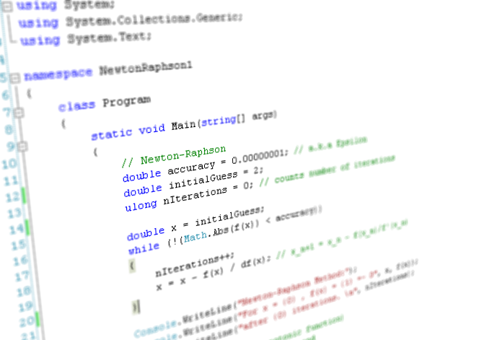
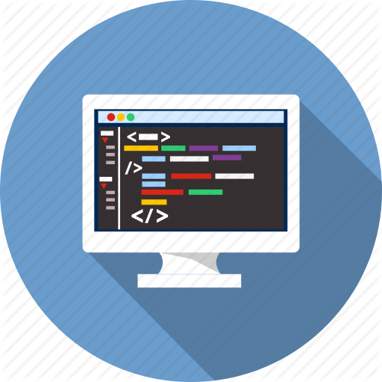
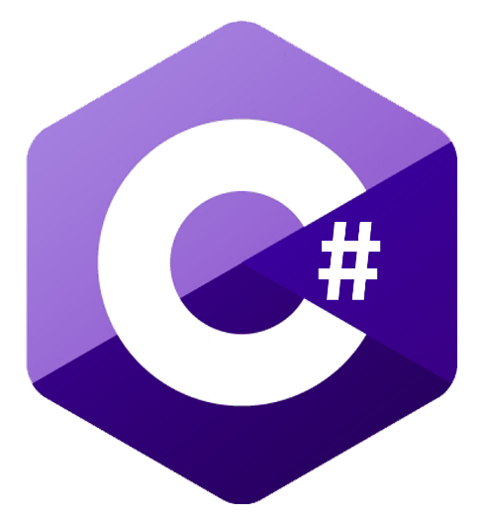
C# OOP Advanced
Course Objectives & Program

Slide 9

Course Topics
SOLID Principles
Generics
Iterators and Comparators
Reflection and Attributes
Unit Testing
Object Communication and Events
3 Workshops
3 Exam Preparations

Slide 10
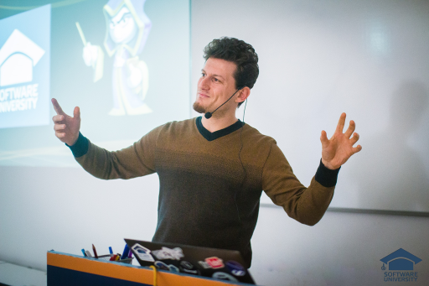
The Trainers Team

Slide 11
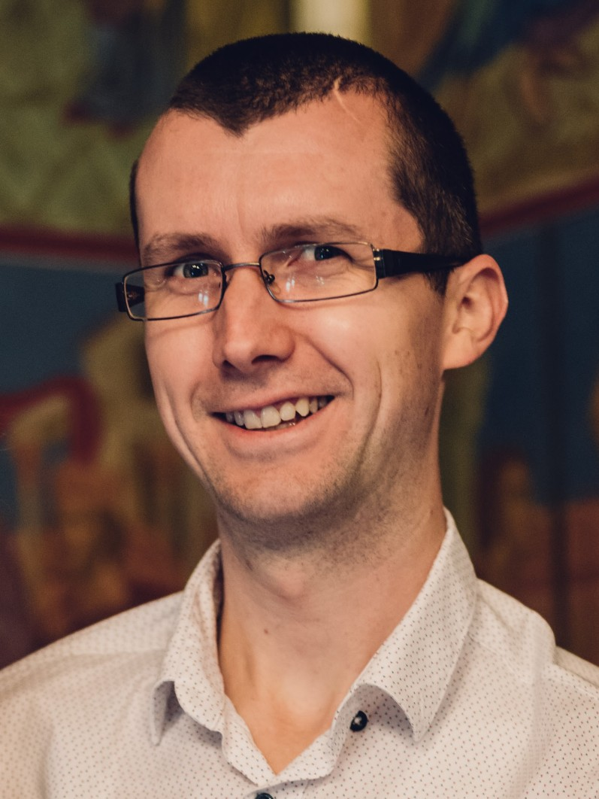
Trainers Team
Yavor Valchev
Senior Programmer with 10 years of experience
Team Lead at Up2 Technology
Interested in mountain hiking, traveling and meeting new people

Slide 12
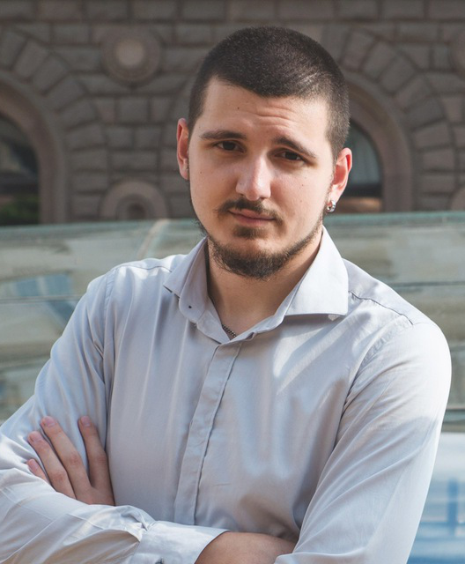
Trainers Team (2)
Bozhidar Danchev
Technical Trainer @ Software University
Top performing student from the Software University
Interested in smart technologies, AI and Gaming

Slide 13
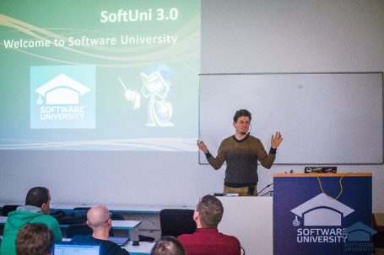


C# OOP Advanced
Course Details and Schedule

Slide 14
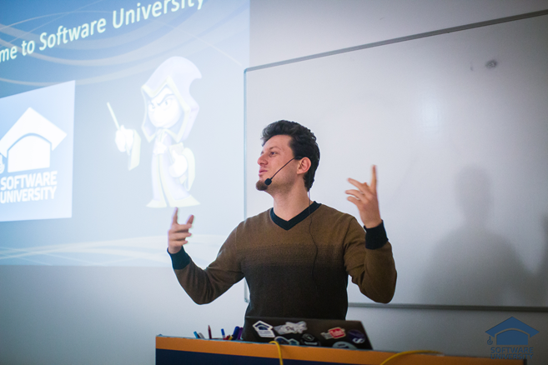
Training Duration and Schedule
Lessons: ~ 50 hours (onsite + YouTube videos)
Practical exercises (in class): ~ 30 hours
Homework: ~ 0-60 hours
Exam preparation: ~20 hours
Time frame
19-Mar-2018 – 22-Apr-2018

Slide 15

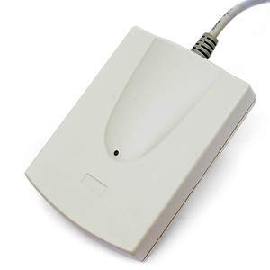
Your RFID Chip
Students can either
Take RFID chip from SoftUni
Or use their own chip / card (125 KHz)
Register your chip number in your SoftUni profile: https://softuni.bg/users/profile/show
Check-in at the reception every time when you come in SoftUni
See your last visits in your profile: https://softuni.bg/users/profile/show

Slide 16


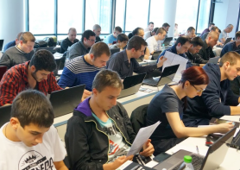
C# OOP Advanced
Evaluation Criteria

Slide 17


Scoring System for the Course
Mandatory:
Final exam – 85%
Exercises & homework – 15%
Bonuses:
Presence in class – 5% bonus
Forum activity – bonus up to 5%
BashSoft – 5% bonus

Slide 18
The OOP Advanced Exam
1 practical problem for 6 hours:
You are given a partially-implemented C# project
You should implement the rest of it and fix any bugs
Use Reflection inside the project
Write Unit Tests for the project

Slide 19


Homework Assignments & Exercises
Your homework is mainly work in class!
Lesson days → slides + live demos + exercises
Exercise days → only exercises
How to submit your homework?
Submitted in the judge system
Do your homework when it's due!
Assignments pile up quickly

Slide 20









Resources
What We Need Additionally?

Slide 21



Course Web Site, Forum and FB Group
Official web site:
Official discussion forum:
Official Facebook group:
https://softuni.bg/courses/csharp-oop-advanced-high-quality-code
softuni.bg/forum/categories/15/
facebook.com/groups/ SoftUniCsharpFundamentalsJanuary2018

Slide 22



The C# OOP Advanced Slides and Videos
All lecture slides, videos, exercises, projects and other resources are open content, available for free
Visit the course web site to access the course resources

Slide 23

The Free C# Fundamentals Textbook
The official textbook for the course
"Fundamentals of Computer Programming with C#", by Svetlin Nakov & Co., 2013, ISBN 9789544007737
English and Bulgarian versions (as PDF, ePub, …)
Freely downloadable from: www.introprogramming.info
The C# Programming courses @ SoftUni.bg partially follows the book

Slide 24


Required Software
Software needed for this course:
Microsoft Windows (Win 10 / 8.1 / Win8 / Win7)
Visual Studio Community 2017 (a free version of VS 2017)
.NET Core 2.1 (included in Visual Studio)

Slide 25
C# OOP Advanced – Course Intro
https://softuni.bg/courses/csharp-oop-advanced-high-quality-code

Slide 26

License
This course (slides, examples, demos, videos, homework, etc.) is licensed under the "Creative Commons Attribution-NonCommercial-ShareAlike 4.0 International" license
Attribution: this work may contain portions from
"Fundamentals of Computer Programming with C#" book by Svetlin Nakov & Co. under CC-BY-SA license

Slide 27





Trainings @ Software University (SoftUni)
Software University – High-Quality Education, Profession and Job for Software Developers
softuni.bg
Software University Foundation
http://softuni.foundation/
Software University @ Facebook
facebook.com/SoftwareUniversity
Software University Forums
forum.softuni.bg

